Slide 1
Websites!
with Grady

Slide 2
2 Down… 1 to Go!
HTML
CSS
JavaScript

Slide 3
Important to remember: Syntax
Computers are very nitpicky and particular about the specific way in which you type your code!
For example: <h1 class = “example”> is okay.
ANYTHING ELSE is not okay
This is especially important in JavaScript because if something is out of place, the program may not work the way you want it to! (or at all...)

Slide 4
JavaScript is super different!
It is a scripting language a.k.a. a programming language for websites
HTML & CSS are not programming languages!
HTML = markup language
CSS = stylesheet
The difference is that the other two languages can tell the computer what to display (HTML) and how to display it (CSS) but they can’t make the computer do anything
JavaScript can make the computer do things!
Everything from animations to data manipulation and more!

Slide 5
How do we use JavaScript?
Everything that your JavaScript does will go inside a function
These functions can be “called” by the webpage in various ways
For example, a button press can call a function, as could loading a new page and pressing a key on the keyboard
When a function is called, the computer runs all the code in that function and then stops

Slide 6
The anatomy of a function
function example () {
var x = “Hello World!”;
}
Let’s go through this short example and identify what all of these things mean...

Slide 7
The anatomy of a function
function example () {
var x = “Hello World!”;
}
This keyword tells the computer that the following code is a function.

Slide 8
The anatomy of a function
function example () {
var x = “Hello World!”;
}
This is the name of the function. You can use this name to call the function from other functions.

Slide 9
The anatomy of a function
function example () {
var x = “Hello World!”;
}
Sometimes, we may want to send a variable from another part of the program into our function. We would type the variables in between these parenteses. We won’t be doing this today.

Slide 10
The anatomy of a function
function example () {
var x = “Hello World!”;
}
These are the opening curly brace and the closing curly brace. All of the code in this program must go between these curly braces.

Slide 11
The anatomy of a function
function example () {
var x = “Hello World!”;
}
This line is called a variable declaration. It is when we create a variable in our program that we can use and change in order to accomplish what we need to get done.

Slide 12
The anatomy of a function
function example () {
var x = “Hello World!”;
}
This keyword tells the computer we are creating a variable.

Slide 13
The anatomy of a function
function example () {
var x = “Hello World!”;
}
This is the name of the variable. We can set this to be whatever we want! The only rule is that it has to be one word. So variable name is not okay but variableName is totally okay.

Slide 14
The anatomy of a function
function example () {
var x = “Hello World!”;
}
This equals sign is used to set a value to a variable. The values can be a number, text, etc.

Slide 15
The anatomy of a function
function example () {
var x = “Hello World!”;
}
This is the value of the variable. When it is text (like it is above) then we must put it in quotation marks.

Slide 16
The anatomy of a function
function example () {
var x = “Hello World!”;
}
This semicolon marks the end of a single line of code. Every line will end in a semicolon such as this one.

Slide 17
The <script> tag
Each language has their own unique tag for where the code for that language goes.
HTML tag is <html>
CSS tag is <style>
JavaScript tag is <script>
All JavaScript code goes in between the opening tag <script> and the closing tag </script>

Slide 18
Let’s write some JavaScript!
We are going to make a site where you push a button and make a secret message pop up!

Slide 19
Let’s write some JavaScript!
<!DOCTYPE html>
<html>
<h1>Hello world!</h1>
</html>

Slide 20
Let’s write some JavaScript!
<!DOCTYPE html>
<html>
<h1>Hello world!</h1>
<button>Click me!</button>
</html>

Slide 21
Let’s write some JavaScript!
<!DOCTYPE html>
<html>
<h1>Hello world!</h1>
<button onclick = "displayMessage()">Click me!</button>
</html>

Slide 22
Let’s write some JavaScript!
<!DOCTYPE html>
<html>
<h1>Hello world!</h1>
<button onclick = "displayMessage()">Click me!</button>
</html>
<script>
</script>

Slide 23
Let’s write some JavaScript!
<!DOCTYPE html>
<html>
<h1>Hello world!</h1>
<button onclick = "displayMessage()">Click me!</button>
</html>
<script>
function displayMessage () {
alert("Secret message goes here!");
}
</script>

Slide 24
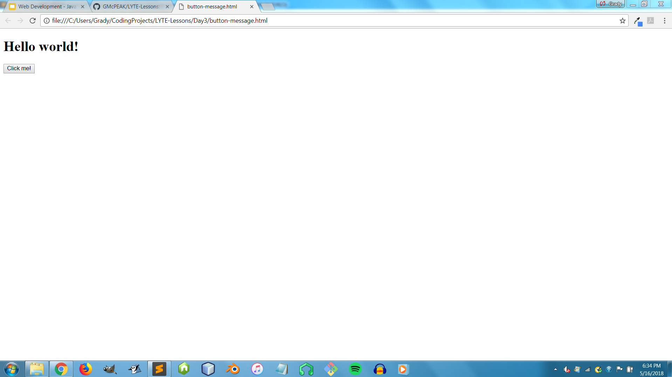
Let’s write some JavaScript!
Your site should look like this...

Slide 25
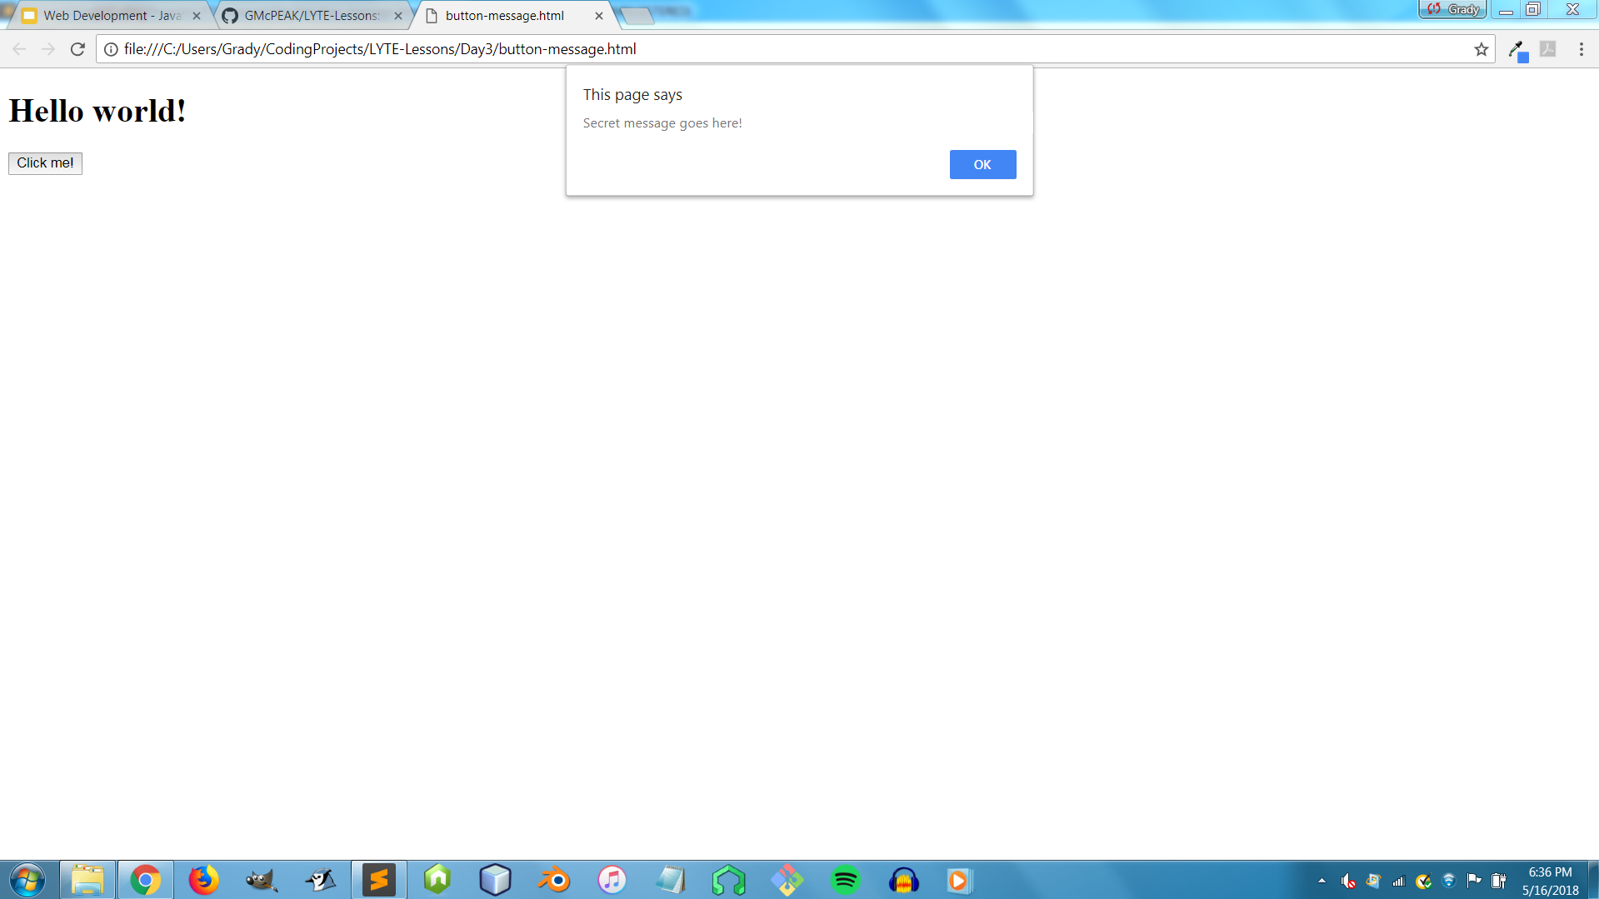
Let’s write some JavaScript!
And when you press the button, it should look like this...

Slide 26
Mixing all 3 languages!
Here, all three languages are working together to create something!
<!DOCTYPE html>
<html>
<h1 id = "colorful">Hello world!</h1>
<button onclick = "changeColor()">Click me!</button>
</html>
<script>
function changeColor () {
var x = document.getElementById("colorful");
x.style.color = "blue";
}
</script>

Slide 27
Mixing all 3 languages!
HTML in red
<!DOCTYPE html>
<html>
<h1 id = "colorful">Hello world!</h1>
<button onclick = "changeColor()">Click me!</button>
</html>
<script>
function changeColor () {
var x = document.getElementById("colorful");
x.style.color = "blue";
}
</script>

Slide 28
Mixing all 3 languages!
CSS in blue
<!DOCTYPE html>
<html>
<h1 id = "colorful">Hello world!</h1>
<button onclick = "changeColor()">Click me!</button>
</html>
<script>
function changeColor () {
var x = document.getElementById("colorful");
x.style.color = "blue";
}
</script>

Slide 29
Mixing all 3 languages!
JavaScript in green
<!DOCTYPE html>
<html>
<h1 id = "colorful">Hello world!</h1>
<button onclick = "changeColor()">Click me!</button>
</html>
<script>
function changeColor () {
var x = document.getElementById("colorful");
x.style.color = "blue";
}
</script>

Slide 30
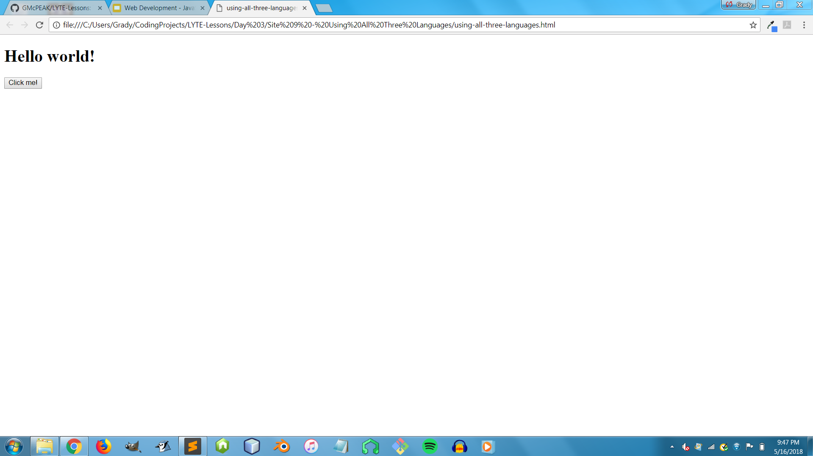
Mixing all 3 languages!
(Before button click)

Slide 31
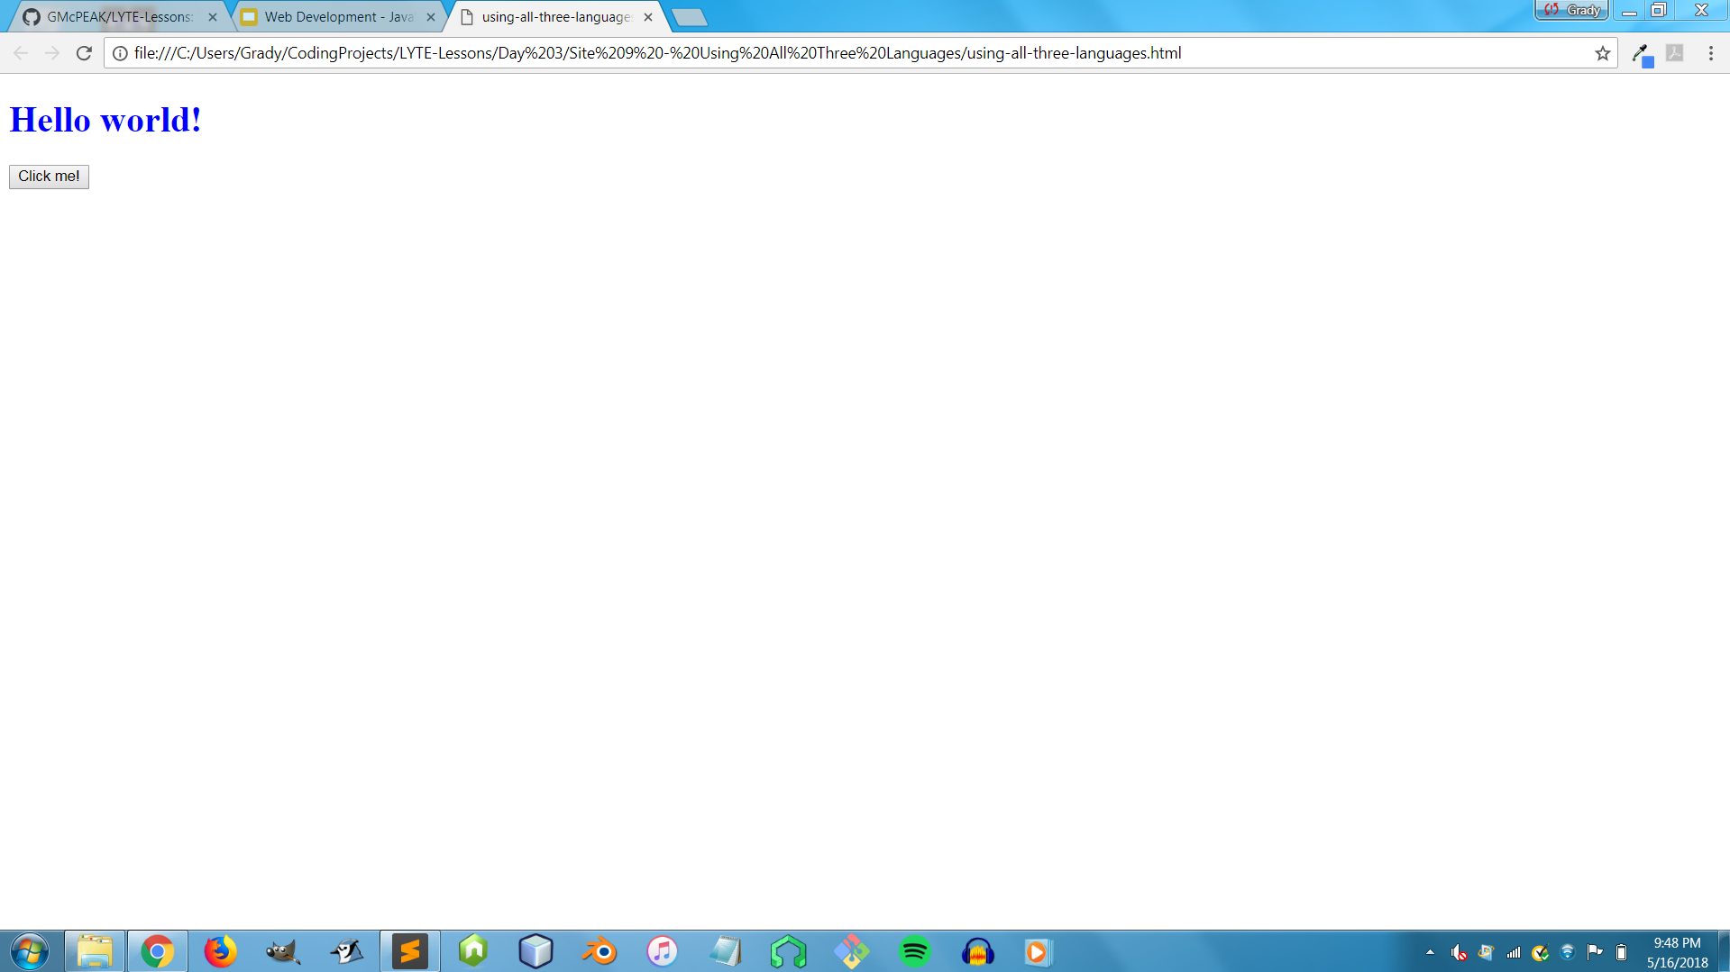
Mixing all 3 languages!
(After button click)

Slide 32

Resources
All webpages, slide shows, images, and bonus sites from these lessons can be found on a website called GitHub.
You can find all this stuff at https://github.com/GMcPEAK/LYTE-Lessons

Slide 33
Resources
The sources below are excellent for various aid and further instruction on how to learn even more about code!
W3Schools - web pages on various important concepts in web development
FreeCodeCamp - free interactive walkthrough lessons on programming
Codecademy - more learning and instruction
StackOverflow - a forum where people can post code-related questions and other users can provide answers
… and more!

